Slide 1
C & S Food Show Collection Mohegan Sun March 11, 2025
53, 541 pounds of food and household items collected
63 volunteers
Thank you!!

Slide 3
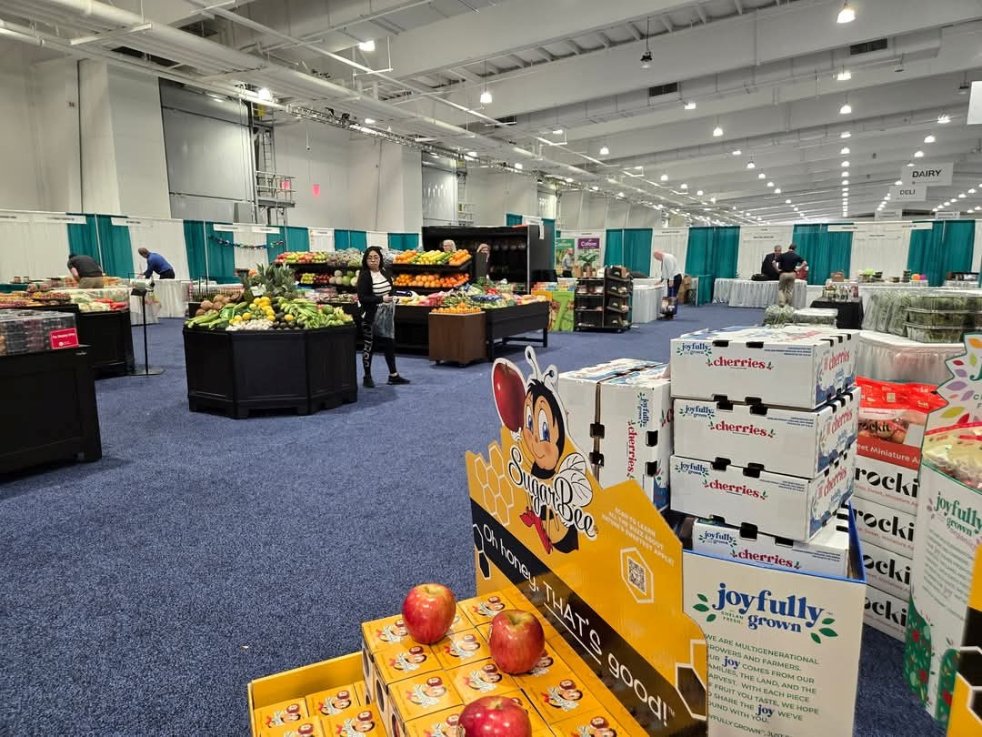

Slide 4
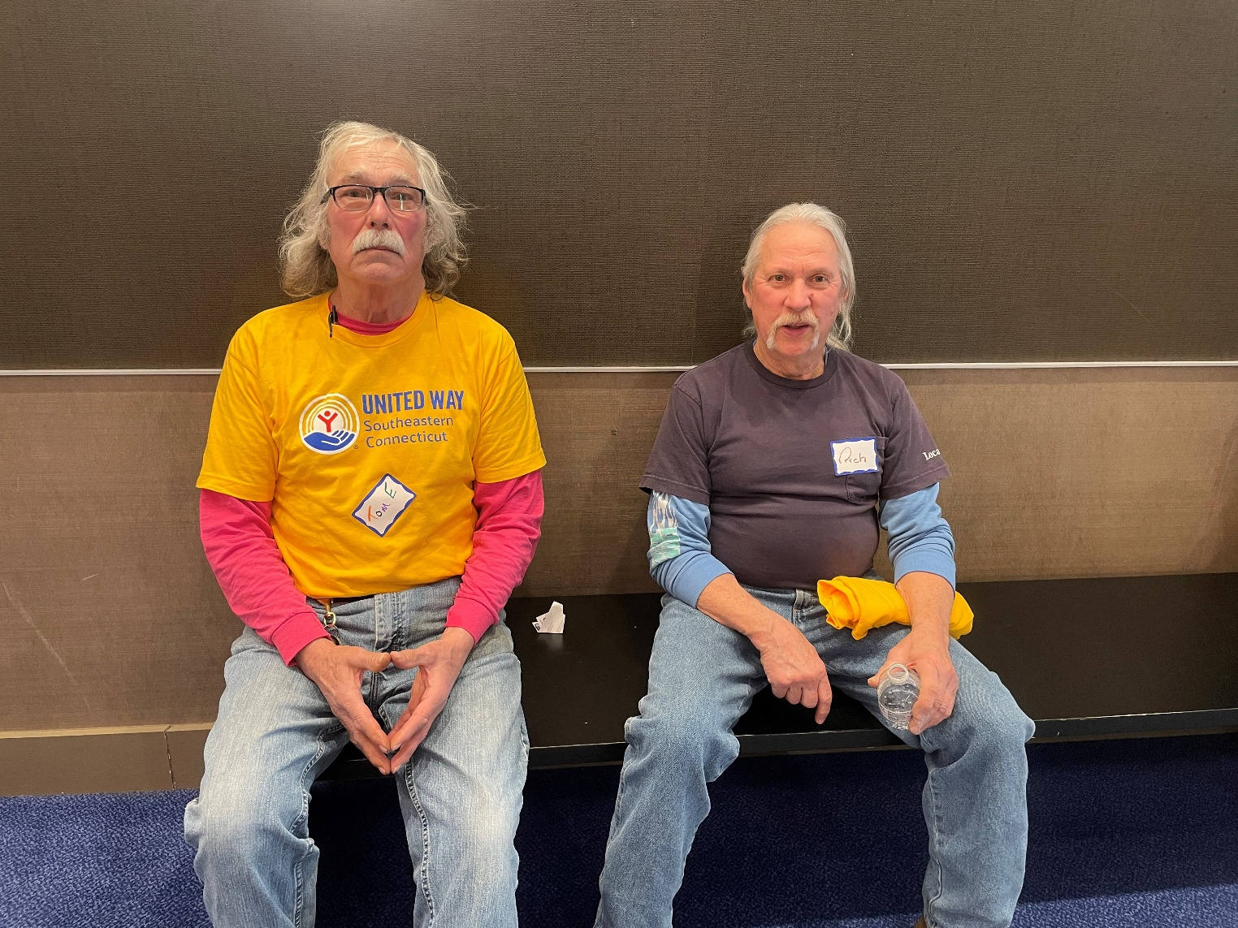

Slide 6
